Slide 1
Scipy.in 2012, IIT-B
A simple Python based tool for preparing randomized multi-set multiple choice question papers
Pecha Kucha Presentation
December 27-29 2012
Ashish Sharma
Professor, Mechanical Engineering
DIT, Dehradun

Slide 2
The Problem
A class full of students
So much to teach
Frequent, continuous evaluations – QUIZES
Multiple choice or objective type questions
Not enough invigilators
Time constraints
Quality of evaluations

Slide 3
The Solution
Randomized multiple choice question papers – orders of questions and answers
Python - for the randomized text manipulation
The input is a set of three text (txt or tex) files containing – the questions and the answers, the header and the footer
The output is a chosen number question papers containing the same sets of questions and answer choices – both randomly differentiated in terms of order

Slide 4
The Code – imports
import sys, random
import fileinput
from subprocess import call
........
infilename = sys.argv[1]
...........
for line in fileinput.input( infilename ):
...........
random.seed()
...........
call(['latex', outfilename + ".tex"])

Slide 5
The Randomization
import sys, random
...........
random.seed()
...........
random.shuffle(qseq)
...........
...........
random.shuffle(opseq)

Slide 6
Case 1 – “.txt” file
An example content:
A force can provide
only a pull
only a push
neither a push nor a pull
either a push or a pull
State of motion of an object is defined
only when it is at rest
only when it is in motion
neither when it is at rest nor when it is in motion
both when it is at rest as well as when it is in motion
Which of the following is not an example of a non-contact force?

Slide 7
Case 1 (contd.) – the header file
Stuff like:
XYZ Institute of Technology and Science
Science Quiz No. 1
25 December 2012
Note:(i) Attempt all questions
(ii) Clearly mark the most appropriate answer from the given options
(iii) Every correct answer gives two marks
(iv) Every wrong answer deducts one mark

Slide 8
Case 1 (contd.) – the footer file
Stuff like:
BYE, HAVE A NICE DAY!
(Space for pasting numbered figures)

Slide 9
The Code Snippets – for text only
if infilenameparts[1] == "txt":
OpIndices = [ "(A)", "(B)", "(C)", "(D)"]
...................
...................
outfile.write("Q. %d: %s\n" % ( (li + 1), allQs[qseq[li]] ) )
...................
...................
outfile.write("%s %s %s %s %s %s %s %s\n" % ( OpIndices[0], allOps[qseq[li]*4 + opseq[0]], OpIndices[1], allOps[qseq[li]*4 + opseq[1]], OpIndices[2], allOps[qseq[li]*4 + opseq[2]], OpIndices[3], allOps[qseq[li]*4 + opseq[3]] ) )

Slide 10
A Typical Session – for text only
$ ./otqpr.py
Usage: ./otqpr.py infile.[txt/tex] N
N being the number of versions to be created.
infileH.[txt/tex] and infileF.[txt/tex] must exist to define the header and the footer
$ ls
in1F.txt in1H.txt in1.txt otqpr.py
$ ./otqpr.py in1.txt 3
$ ls
in1F.txt in1H.txt in1_OUTV0.txt in1_OUTV1.txt in1_OUTV2.txt in1.txt otqpr.py

Slide 11
The Outputs – formatted .txt files
VERSION 1
Q. 1: The reason we are not crushed under the atmospheric pressure is
(A) the pressure inside us is almost same as the atmospheric pressure (B) the pressure is too small (C) we are strong enough (D) the resulting force is too small
Q. 2: A force can be providing
(A) neither a push nor a pull (B) either a push or a pull (C) only a pull (D) only a push
VERSION 2
Q. 1: The reason we are not crushed under the atmospheric pressure is
(A) we are strong enough (B) the pressure is too small (C) the pressure inside us is almost same as the atmospheric pressure (D) the resulting force is too small
Q. 4: A force can be providing
(A) neither a push nor a pull (B) either a push or a pull (C) only a push (D) only a pull

Slide 12
Case 2 - The LaTeX input file
If the input is a tex file, it enables several enhancements like – formatting, mathematical symbols, figures etc.
The tex input file is accompanied by a header and a footer file
The header file contains the usual preamble and the common components like time, total marks, duration etc.
The footer file primarily has a numbered set of figures

Slide 13
Case 2 – “.tex” file
An example content:
The reason we are \emph{not} crushed under the atmospheric pressure is
the pressure is too small
the resulting force is too small
we are strong enough
the pressure inside us is almost same as the atmospheric pressure
If an object 1 shown in figure {\bf Fig. 1} is made to slide in the direction A on a static surface 2, which of the following is true regarding the friction force acting on the surface 2.
No such friction force occurs
It can be in any direction
It acts in the direction A
It acts in the direction opposite to A

Slide 14
The Header – in1H.tex
Stuff like:
\documentclass[10pt]{article}
..................
XYZ Institute of Technology and Science\\
\hspace{35ex}
Science Quiz No. 1
.....................
..................
{\bf Note:}(i) Attempt all questions
(ii) Clearly mark the \emph{most} appropriate answer from the given options
(iii) Every c.......................

Slide 15
The Footer – in1F.tex
Stuff like:
\makebox[0.25\textwidth]{
\begin{pspicture}(1,1)
\rput(0.5,0.5){\includegraphics[height=0.2\textwidth]{Fig2.eps}}
\rput(0.5,0){Fig. 2}
\end{pspicture}
}
\bf\centering +++BYE, HAVE A NICE DAY!+++
\end{document}
~

Slide 16
The Figures
\makebox[0.25\textwidth]{
\begin{pspicture}(-0.5,-0.5)(0.5,0.5)
{\psset{fillcolor=blue,fillstyle=none,drawCoor= ...
........
........
\end{pspicture}
}
\makebox[0.25\textwidth]{
\begin{pspicture}(1,1)
\rput(0.5,0.5){\includegraphics[height=0.2\textwidth]{Fig2.eps}}
\rput(0.5,0){Fig. 2}
\end{pspicture}
}

Slide 17
A Typical Session – for latex input
$ ./otqpr.py
Usage: ./otqpr.py infile.[txt/tex] N
N being the number of versions to be created.
infileH.[txt/tex] and infileF.[txt/tex] must exist to define the header and the footer
$ ls
Fig2.eps in1F.tex in1H.tex in1.tex otqpr.py
$ ./otqpr.py in1.tex 3
$ ls
Fig2.eps in1F.tex in1H.tex in1_OUTV0.pdf in1_OUTV1.pdf in1_OUTV2.pdf in1.tex otqpr.py

Slide 18
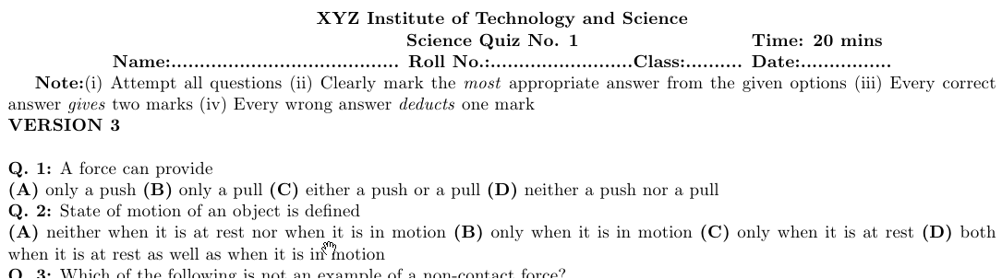
A Typical output – for latex input

Slide 19
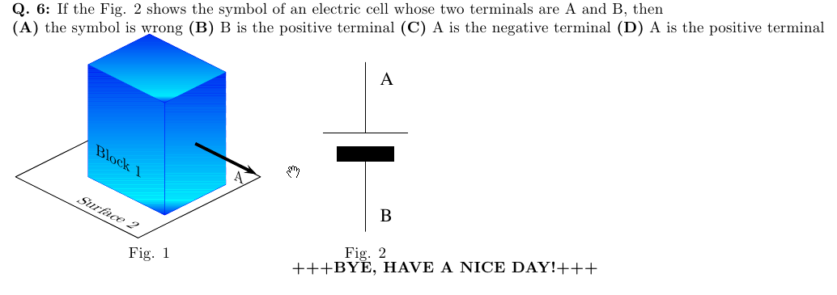
A Typical output (contd.) – for latex input

Slide 20
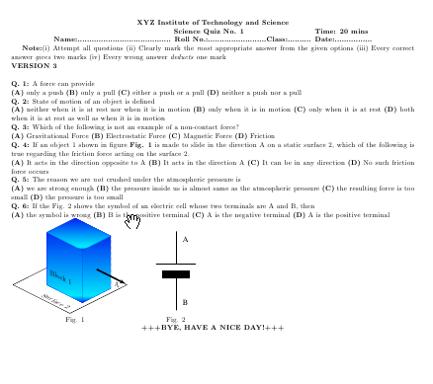
THANKS

